Slide 1
Classifying FMCG Products
-Dhivya Swaminathan

Slide 2
Metrics used
The Metrics used here are
Relative Volume sales over each quarter for two years (dv/dq)
Relative Price over each quarter for two years (dp/dq)
Relative No of stores over each quarter for two years (ds/dq)
For Example:
Relative volume sales for 2012 Q2 = (Volume sales of 2012 Q2 – Volume sales 2012 Q1)

Slide 3
Classifiers Definition
The Classifier used categorises variants with respect to variant -1163
The method used:
Graph axis definitions:
X-Axis : Quarters of years 2012 and 2013
(Why? – Because variant – 1163 was launched in 2012-mid, analysis of trend for two years alone have been considered)
Y-Axis : Change in Volume sales with respect to previous quarter (dv/dq)
Classifier algorithm used:
Each Quarter’s dv value is assigned any one of the following four categories and assigned a value as shown
High growth in sales – (if dv/dq > mean (high growth sales)) – (Value assigned – 1)
Little growth in sales – (if dv/dq < mean (Little growth sales) and dv/dq>0)- (Value assigned – 2)
Little Drop in sales – (if dv/dq < 0 and dv/dq >(Little drop sales))- (Value assigned – 3)
High Drop in sales – if(dv/dq < mean(High drop sales)) - (Value assigned – 4)
Similarly, the same is done for price change and no of stores change

Slide 4
Modifications in the Classifiers
Drawbacks of the classifier used:
There is an almost nil chance that two products follow the exact same trend in the market
Classifying thus would result in one product in each bin, hence not serving the purpose.
Therefore, a small tweak has to been done to overcome this setback
After the said classifier algorithm is run, variant-1163 has a value of 41114114 and variant 734 has 41214111.
Comparing these both, 6 quarters follow same trend. Therefore, a new variable – MATCH% is introduced.
MATCH% = (Total number of quarters matched/ 8 (total number of quarters considered here))x100
i.e., in the said example, variant-734 ‘s MATCH% is ((6/8)x100)=75%

Slide 5
Contd..
Therefore, all those falling under MATCH% >70 will be considered for supplementary analysis.
This has to be repeated for change in price and change in number of stores.
All those variants falling in the intersection of all three parameters would be considered for supplementary analysis.
From these, all those falling under the same primary benefit and body part will be taken as competitors.

Slide 6
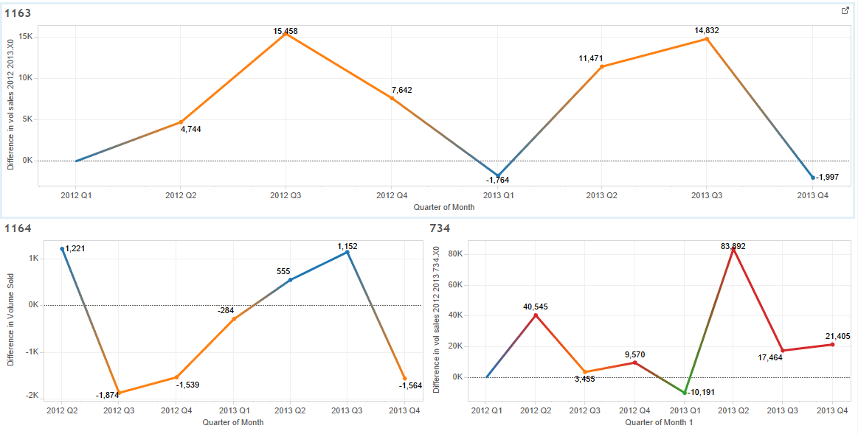
Trend analysis

Slide 7
Inferences
At a high level analysis (taking 4 variants for dry run), the following were the results:
Variant-1163 – 41114114
Variant-734 – 41214111 – MATCH% of 75
Variant-1162 – 41444134 – MATCH% of 50
Variant-1164 – 41444114 – MATCH% of 75
From this we can infer that variant – 1164 and 734 follow 75% of similar trend of variant-1163 and can be considered for competitor analysis.

Slide 8
Business Insights uncovered
This shows two things
The variant-1164
is similar to variant-1163 on the basis of sales trends over time
it is on a similar scale to variant -1163
therefore, we can take this directly as falling in the same bucket as that of variant-1163
The variant-734
has very similar sales trend over time as that of variant – 1163
but it is on a much larger scale compared to variant-1163
this means we cannot put it on the same bucket as variant – 1163 , but , we can analyse the effect it has on itself, that is, with its price change, how is its own sales getting affected? And such similar questions can be looked into upon further.

Slide 9
Over all Effort - Time spent and Overall Progress - Clarity in completion time
Time spent : 8 hours
Now that a classifier has taken shape, the following tasks remain:
Coding the classifier in R – 2 hours
Answering the given 5 questions – 8 to 12 hrs
Total Time to finish the assignment = 2 + 12 = 14 hrs +/- 2 hrs

